Slide 1
2nd IEEE European Symposium on Security and Privacy

Slide 2
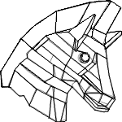
2nd IEEE European Symposium on Security and Privacy
26-28 April 2017, Paris

Slide 3
Previous edition: Saarbrücken, 2016
First edition of Euro S&P
Very successful
150 participants
29 accepted papers out of 170 submissions
17 % acceptance rate
Keynote speaker: Adi Shamir

Slide 4
Next edition: Paris, 2017
Photo: Benh LIEU SONG - Own work, GFDL, https://commons.wikimedia.org/w/index.php?curid=3531130 (cropped)

Slide 5
Next edition: Paris, 2017
Photo: Myrabella / Wikimedia Commons, CC BY-SA 4.0, https://commons.wikimedia.org/w/index.php?curid=32161197

Slide 6
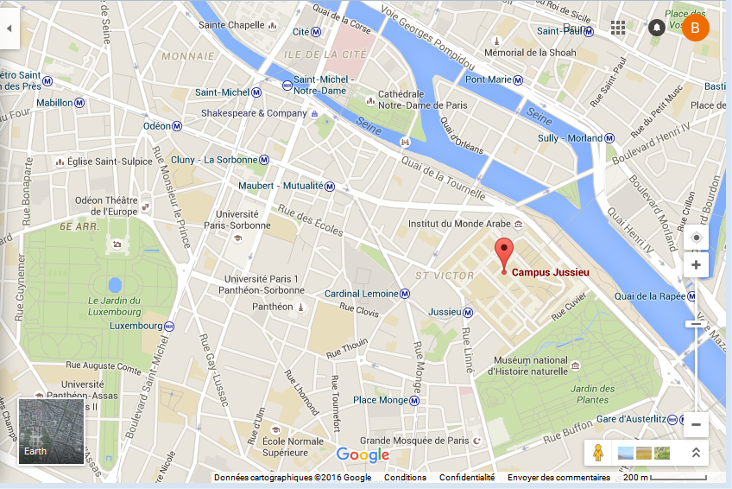
Next edition: Paris, 2017

Slide 7
Next edition: Paris, 2017
Conference: 26-28 April 2017
right before EuroCrypt (also in Paris)
affiliated events 29-30 April, joint with EuroCrypt
Submission deadline: August 2016
PC chairs: Andrei Sabelfeld and Matthew Smith
General chair: Cătălin Hrițcu
http://www.ieee-security.org/TC/EuroSP2017/

